Slide 1

Coping with decision-making and uncertainty in post-normal science.
Kate Wright

Slide 2
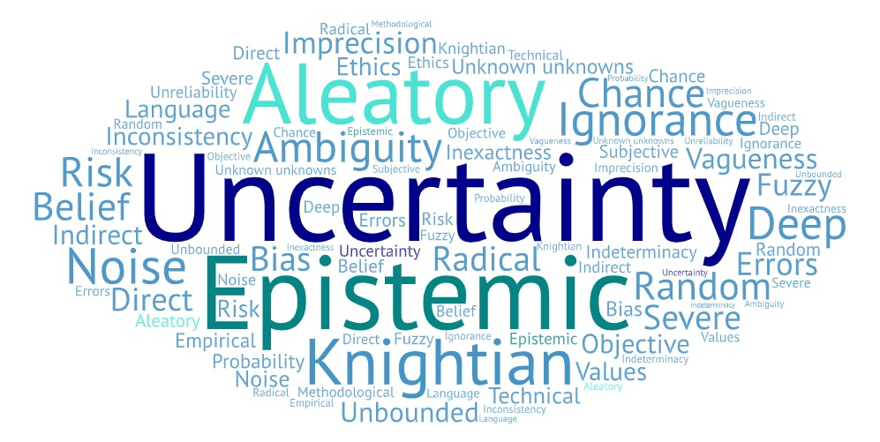

Slide 3
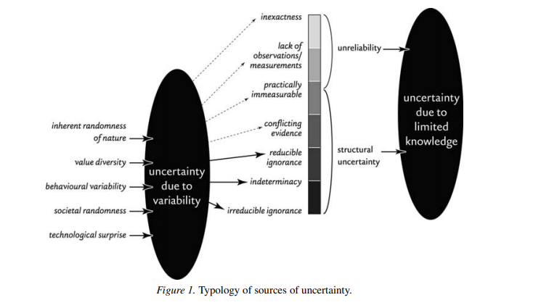
van Asselt, M.B.A., Rotmans, J. Uncertainty in Integrated Assessment Modelling. Climatic Change 54, 75–105 (2002). https://doi.org/10.1023/A:1015783803445

Slide 4
Post-normal science (PNS)
Developed in mid 1980s by Funtowicz and Ravetz because:
  Scientific problems becoming increasingly complex
  Facts are uncertain
  Decisions are urgent
So need:
  Quality control
  Management of uncertainties
  'Extended peer communities'
References if want to follow up: ​
Funtowicz, S.O. and Ravetz, J.R., 1990. Uncertainty and quality in science for policy (Vol. 15). Springer Science & Business Media.
Funtowicz, Silvio O. and Ravetz, Jerome R, 1993, Science for the post-normal age, Futures, Volume 25, Issue 7, Pages 739-755, https://doi.org/10.1016/0016-3287(93)90022-L.​
www. Nusap.net

Slide 5
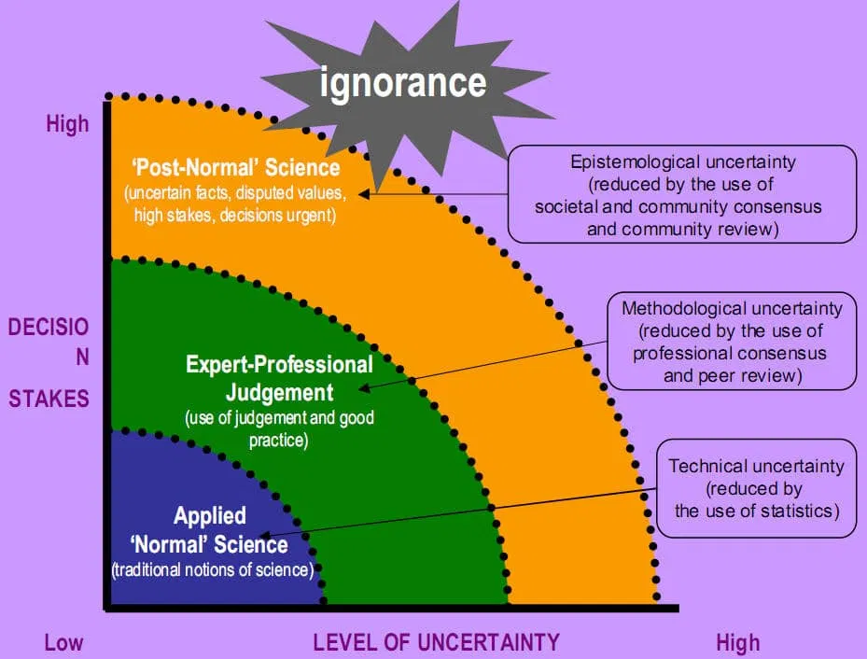
From: https://caffeinatedthoughts.com/2014/09/calvin-beisner-post-normal-science/

Slide 6
Summary
  Many different sources of uncertainty
  PNS provides a framework for uncertainty management
  Can be used to communicate the different uncertainties to decision makers – from risk to ignorance
  Can show the importance of different uncertainties and how they can affect a decision
  Involvement of stakeholders - allows for clarification of what is needed to enable decisions vs the research done/to be done/ability to do
  Implications for Environmental Data Science – increased interdisciplinarity; consideration of areas of conflict – methods, language, assumptions; increased documentation.

Slide 7
Thank you for listening.
If you have any thoughts or feedback : k.wright@lancaster.ac.uk
Some other references:
Beven, K. 2009. Environmental modelling : An uncertain future? : An introduction to techniques for uncertainty estimation in environmental prediction. London: Routledge.
Parsons, S., 2001. Qualitative methods for reasoning under uncertainty (Vol. 13). Mit Press.
Wynne, B., 1992. Uncertainty and environmental learning: reconceiving science and policy in the preventive paradigm. Global environmental change, 2(2), pp.111-127.

